Slide 1
Session 24: Ad. Java IO Module 4.2: Core Java

Slide 2
Learning Objectives
At the end of the session successful participants will be able to
Define Streams and IO Streams
Differentiate Byte Stream and Character Stream
Describe hierarchy of Input and Output Readers
Read or Write data to/from a resource (file) using Readers

Slide 3
I/O Stream
Types of Stream
Byte stream
Can access the file byte by byte.
Base class for byte stream are:
The InputStream Class
The OutputStream Class
Both classes are abstract.

Slide 4
I/O Stream
Stream Class Hierarchy
FileInputStream
LineNumberInputStream
PipedInputStream
DataInputStream
FilterInputStream
BufferedInputStream
InputStream
ByteArrayInputStream
PushbackInputStream
SequenceInputStream
StringBufferInputStream
ObjectInputStream

Slide 5
I/O Stream
Stream Class Hierarchy
FileOutputStream
PipedOutputStream
DataOutputStream
OutputStream
FilterOutputStream
BufferedOutputStream
ByteArrayOutputStream
PrintStream
ObjectOutputStream

Slide 6
I/O Stream
File Input Stream Class:
FileInputStream Class is used for reading data from the files.
FileInputStream Class
FileInputStream fis=new FileInputStream(String filepath);
Example:
FileInputStream f = new FileInputStream("home/talentsprint.txt");
This takes a file name as a string to create inputstream object.
FileInputStream fis=new FileInputStream(File fileObj);
Example:
FileInputStream f = new FileInputStream(f);
This takes the file object 'f' to create input stream object.

Slide 7
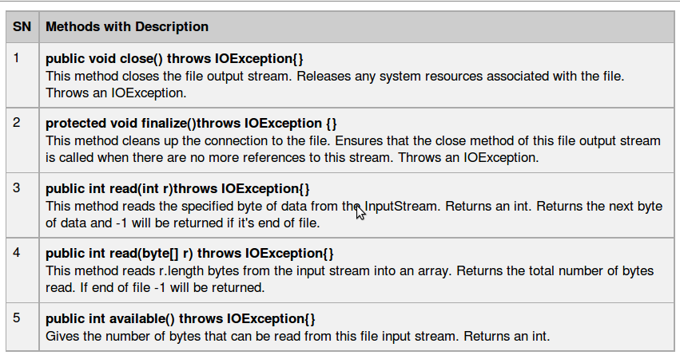
I/O Stream
Methods of File Input Stream Class

Slide 8
I/O Stream
File Output Stream Class:
FileOutputStream is used to create a file and write data into it. The stream would create a file, if it doesn't already exist, before opening it for output.
FileOutputStream fos=FileOutputStream(String filePath)
Example:
FileOutputStream f = new FileOutputStream("home/talentsprint.txt");
This takes a file name as a string to create outputstream object.
FileOutputStream fos=FileOutputStream(File fileObj)
Example:
FileOutputStream f = new FileOutputStream(f);
This takes the file object 'f' to create output stream object.

Slide 9
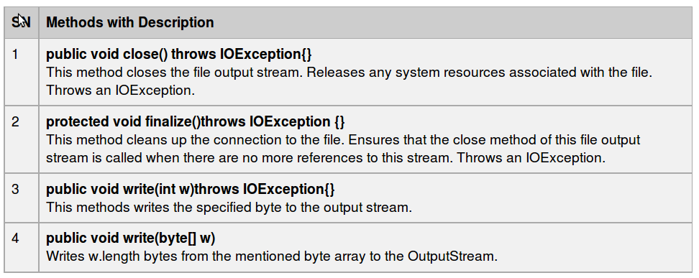
I/O Stream
Methods of File Output Stream Class

Slide 10
I/O Stream
IO Stream
1 2 3 4 5 6 7 8 9 10 11 12 13 14 15 16 17 18 19 20 21 22 23 | /* This program reads the contents of file 'talent.txt' and writes the contents on to another file named 'a.txt'.*/ import java.io.*; class FileReadWriteDemo{ public static void main(String args[]){ try{ File f=new File("talent.txt"); FileInputStream fis=new FileInputStream(f); FileOutputStream fos=new FileOutputStream(“data.txt”); int i=fis.read(); while(i!=-1){ fos.write(i); i=fis.read(); } } catch(Exception e){ System.out.println("file not found"); } } }
Note: The program will create file ‘data.txt', if the file is not existing.

Slide 11
I/O Stream
Node Streams
Type | Character Streams | Byte Streams
File | FileReader FileWriter | FileInputStream FileOutputStream
Memory: Array | CharArrayReader CharArrayWriter | ByteArrayInputStream ByteArrayOutputStream
Memory: String | StringReader StringWriter | N/A
Pipe | PipedReader PipedWriter | PipedInputStream PipedOutputStream

Slide 12
I/O Stream
Buffered Streams
This program performs a copy file operation using a built-in buffer:
java TestBufferedStreams file1 file2
import java.io.*;
public class TestBufferedStreams {
public static void main(String[] args) {
try {
FileReader input = new
FileReader(args[0]);
BufferedReader bufInput = new
BufferedReader(input);
try {
FileWriter output = new
FileWriter(args[1]);

Slide 13
I/O Stream
Buffered Streams
BufferedWriter bufOutput= new BufferedWriter(output);
try {
String line;
// read the first line
line = bufInput.readLine();
while ( line != null ) {
// write the line out to the
//output file
bufOutput.write(line, 0, line.length());
bufOutput.newLine();
// read the next line
line = bufInput.readLine();
}
} finally {
bufOutput.close();

Slide 14
I/O Stream
Buffered Streams
}
} finally {
bufInput.close();
}
} catch (IOException e) {
e.printStackTrace();
}
}
}

Slide 15
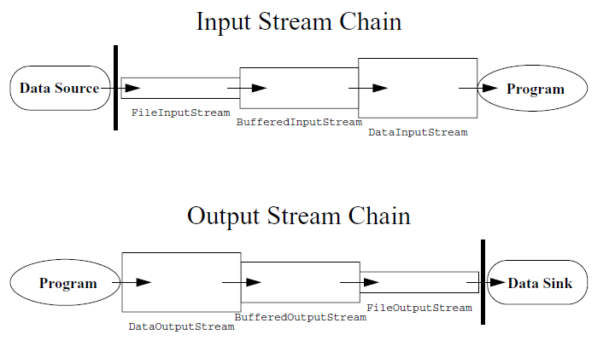
I/O Stream
I/O Streams Chaining

Slide 16
I/O Stream
I/O Streams Chaining

Slide 17
I/O Stream
Processing Streams
Type | Character Streams | Byte Streams
Buffering | BufferedReader BufferedWriter | BufferedInputStream BufferedOutputStream
Filtering | FilterReader FilterWriter | FilterInputStream FilterOutputStream
Converting between bytes and characters | InputStreamReader OutputStreamReader
Performing objects serialization |  | ObjectInputStream ObjectOutputStream

Slide 18
I/O Stream
Processing Streams
Type | Character Streams | Byte Streams
Performing data conversion |  | DataInputStream DataOutputStream
Counting | LineNumberReader | LineNumberInputStream
Peeking ahead | PushbackReader | PushbackInputStream
Printing | PrintWriter | PrintSream

Slide 19
I/O Stream
The Object InputStream and The Object OutputStream
Class
The Java API provides a standard mechanism (called object serialization) that completely automates the process of writing and reading objects from streams.
When writing an object, the object input stream writes the class name, followed by a description of the data members of the class, in the order they appear in the stream, followed by the values for all the fields on that object.
When reading an object, the object output stream reads the name of the class and the description of the class to match against the class in memory, and it reads the values from the stream to populate a newly allocation instance of that class.
Persistent storage of objects can be accomplished if files (or other persistent storage) are used as streams.

Slide 20
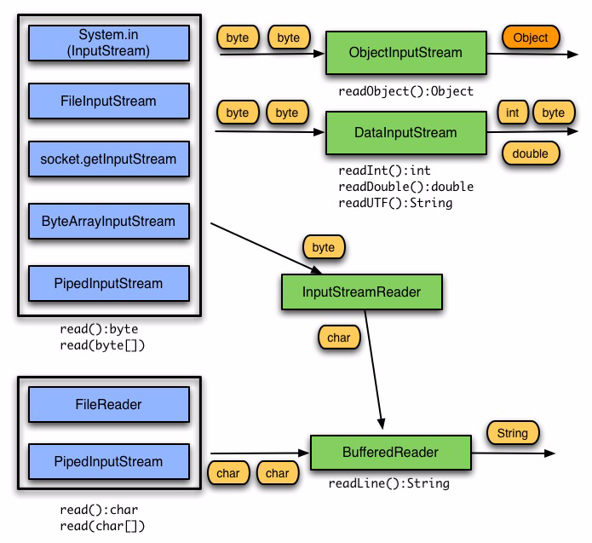
I/O Stream
Input Changing Combinations: A Review

Slide 21
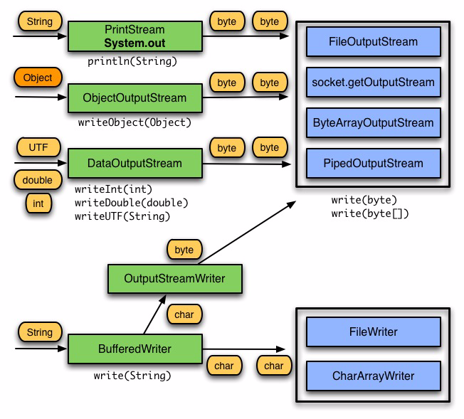
I/O Stream
Output Changing Combinations: A Review

Slide 22
The DataInputStream class
public class DataInputStream extends FilterInputStream implements DataInput
// allow to read primitive data in machine indep. way
Constructor Summary
DataInputStream(InputStream in)
Method Summary
int read(byte[] b [, int offset , int length ] ) // read to array b
void readFully(byte[] [int,int]) // throws EOFException if not fully read
<type> read<Type>( ) // read one data item
<type> is one of boolean, byte, short, int, long, float, double, char
String readUTF() // read a string in UTF8 format (instead of unicode/native)
String readLine() // read next line, deprecated
int readUnsigned<Type>() // <Type> is either Byte or Short
int skipBytes(int n) // always returns n if no exception

Slide 23
Data Output Stream
public class DataOutputStream extends FilterOutputStream implements DataOutput
Constructor Summary
DataOutputStream(OutputStream out)
Method summary
void flush(); int size() // return # of bytes written into this stream
void write(byte[] b [, int off, int len ])
void write<Type>(<type> v) throws IOException;
<type> is any of int, long, float, double.
void write<Type>(int v) throws IOException;
<type> is one of boolean, byte, short or char.
void write<Type>( String s)
<Type> is either Bytes or Chars; for Bytes only low-bytes of s are written
Writes out the string to the underlying output stream as a sequence of bytes or chars.
void writeUTF(String str)
Write str in UTF8 format; (first 2 byte = #bytes written) != str.size() in general.

Slide 24
How to Use Data Input Stream and Data Output Stream
import java.io.*;
public class DataIOTest {
public static void main(String[] args) throws IOException {
// write the data out
DataOutputStream out = new DataOutputStream(new
FileOutputStream("invoice1.txt"));
double[] prices = { 19.99, 9.99, 15.99, 3.99, 4.99 };
int[] units = { 12, 8, 13, 29, 50 };
String[] descs = { "Java T-shirt", "Java Mug", "Duke Juggling Dolls",
"Java Pin", "Java Key Chain" };
for (int i = 0; i < prices.length; i ++) {
out.writeDouble(prices[i]); out.writeChar('\t');
out.writeInt(units[i]); out.writeChar('\t');
out.writeChars(descs[i]); out.writeChar('\n'); }
out.close();

Slide 25
How to Use Data Input Stream and Data Output Stream
// read it in again
DataInputStream in = new DataInputStream(new FileInputStream("invoice1.txt"));
double price; int unit; String desc; double total = 0.0;
try { while (true) {
price = in.readDouble(); in.readChar(); // throws out the tab
unit = in.readInt(); in.readChar(); // throws out the tab
desc = in.readLine();
System.out.println("You've ordered " + unit + " units of " +
desc + " at $" + price);
total = total + unit * price;
} } catch (EOFException e) { }
System.out.println("For a TOTAL of: $" + total);
in.close();
}
}

Slide 26
I/O Stream
Serialization
Serialization is a mechanism for saving the objects as a sequence of bytes and rebuilding them later when needed.
When an object is serialized, only the fields of the object are preserved
When a field references an object, the fields of the referenced object are also serialized
Some object classes are not serializable because their fields represent transient operating system-specific information.

Slide 27
I/O Stream
The Serialize Date Class
import java.io.*;
import java.util.Date;
public class SerializeDate {
SerializeDate() {
Date d = new Date ();
try {
FileOutputStream f =
new FileOutputStream ("date.ser");
ObjectOutputStream s =
new ObjectOutputStream (f);
s.writeObject (d);
s.close ();
} catch (IOException e) {
e.printStackTrace ();

Slide 28
I/O Stream
The Serialize Date Class
}
}
public static void main (String args[]) {
new SerializeDate();
}
}

Slide 29
I/O Stream
The DeSerialize Date Class
import java.io.*;
import java.util.Date;
public class DeSerializeDate {
DeSerializeDate () {
Date d = null;
try {
FileInputStream f =
new FileInputStream ("date.ser");
ObjectInputStream s =
new ObjectInputStream (f);
d = (Date) s.readObject ();
s.close ();
} catch (Exception e) {

Slide 30
I/O Stream
The DeSerialize Date Class
e.printStackTrace ();
}
System.out.println(
"Deserialized Date object from date.ser");
System.out.println("Date: "+d);
}
public static void main (String args[]) {
new DeSerializeDate();
}
}

